Slide 1

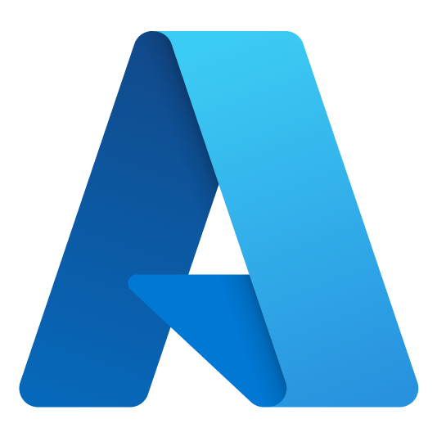
Azure Dev Day 1
Notes:
Welcome to Azure Dev Day

Slide 2




Adam Hems
Principal Cloud Solution Architect
Azure Dev Day
adamhems@microsoft.com
www.linkedin.com/in/adamhems
https://github.com/ahems
Notes:
Introduce yourself

Slide 3
Devs
Notes:
Today is all about YOU – developers
Even if you’re not a dev today should be helpful for you
3 target groups
Never used Azure – gain basic concepts
Familiar with Azure – understand common architectural patterns
Very knowledgeable – pick up some interesting nuggets

Slide 4


Day 1 Agenda (CDT)
6:30 | Intro and fundamentals
6:45 | 1) Web-based solutions
8:15 | 2) Serverless, event-driven solutions
Notes:
4 content sections today
Each section has
An overview of the solution area
A hands-on lab
Lab is subset of solution area
We’ll also have
Breaks (including lunch)
Lots of FUN!
End around 3:30 Central today

Slide 5
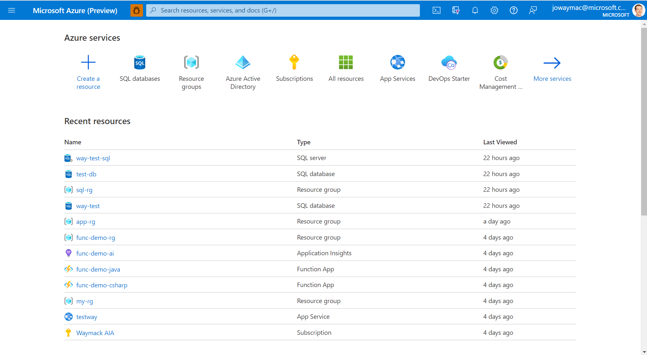

Slide 6



Resource Management
Azure Active Directory Tenant
Azure Subscriptions
Azure Resource Groups
Notes:
Azure Active Directory is the identity provider for provisioning Azure resources
Includes login identities
Includes application/resource identities (service principals)
Source for Role-based-access-control (Identity and Access Management)
Azure subscriptions
Roll-up billing bucket for all Azure provisioned resources

Slide 7
Azure Active Directory
Single organizational Tenant
Management of
Users
Applications
Groups
Role based access control (RBAC)
Owner – Manage everything including RBAC
Contributor – Manage everything except RBAC
Reader – View everything
Notes:
Often called IAM (Identity and Access Management) or RBAC (Roll based access control)
Every resource, resource group, and subscription can have RBAC permissions set on it
The identities or groups you assign RBAC permissions to are tied to the AAD tenant that the subscription is tied to
Use the built-in roles unless you have specific needs

Slide 8
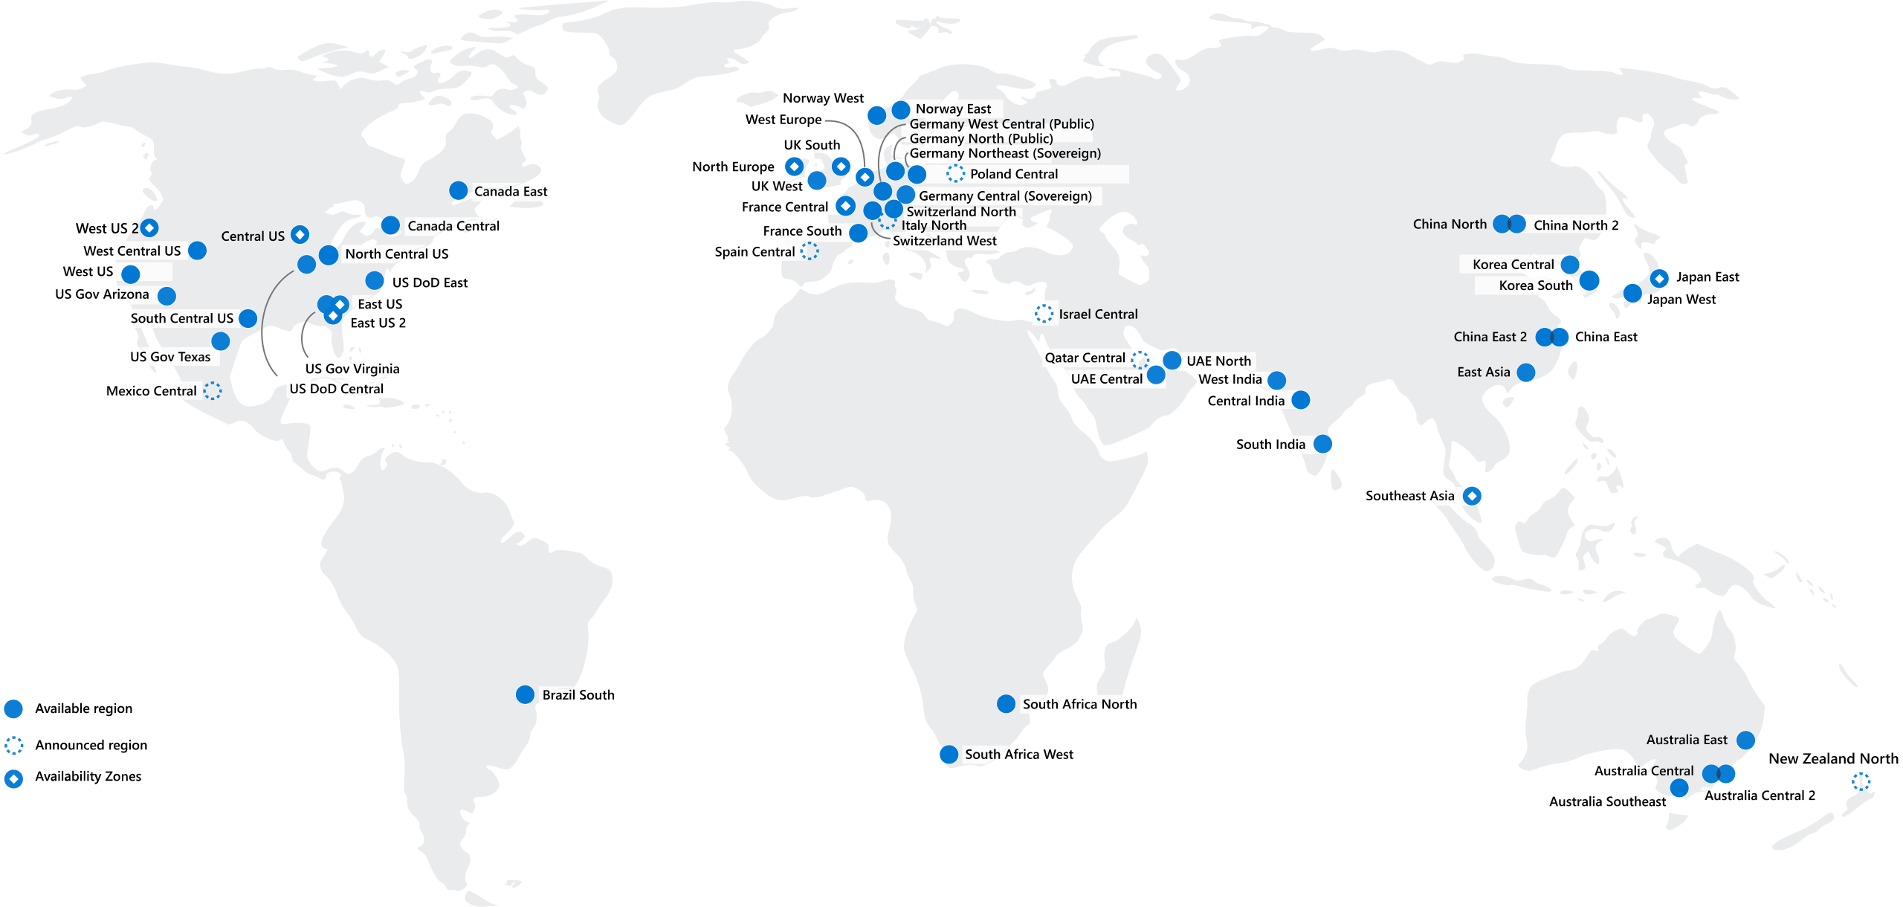
Regions
Notes:
Each region is a set of datacenters
Each datacenter has a very-low latency requirement in a region
New regions going in all the time
Consider which region is closest to your users

Slide 9
Prerequisites
Azure subscription
https://azure.com/free
GitHub Account
https://github.com/signup
Notes:
You’ll need an Azure subscription
A company provided subscription might be locked down for some of the services
You also likely won’t be able to provision app registrations in Azure Active Directory for the DevOps portion
You can create a free subscription
Note: You will have to enter credit card info but you won’t be charged

Slide 10
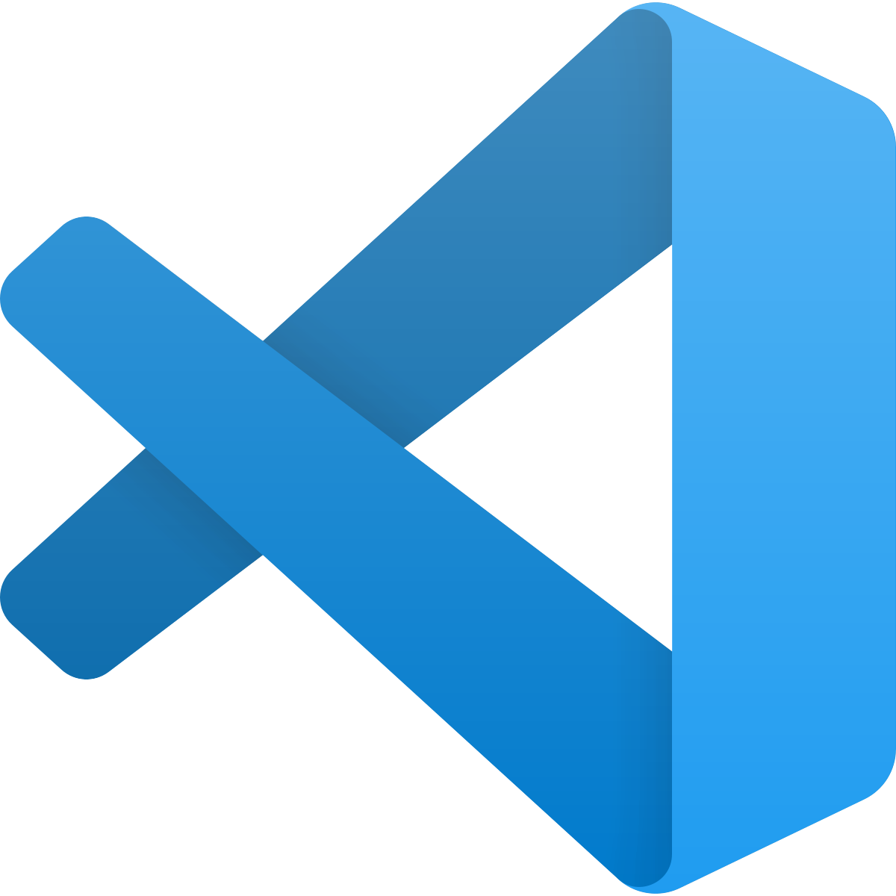
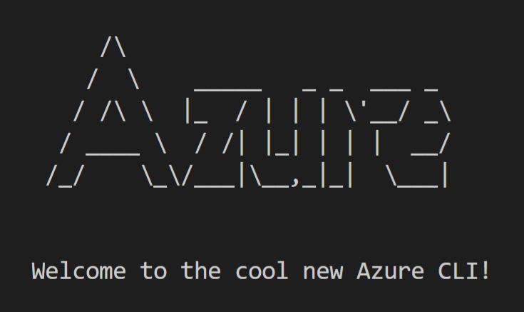



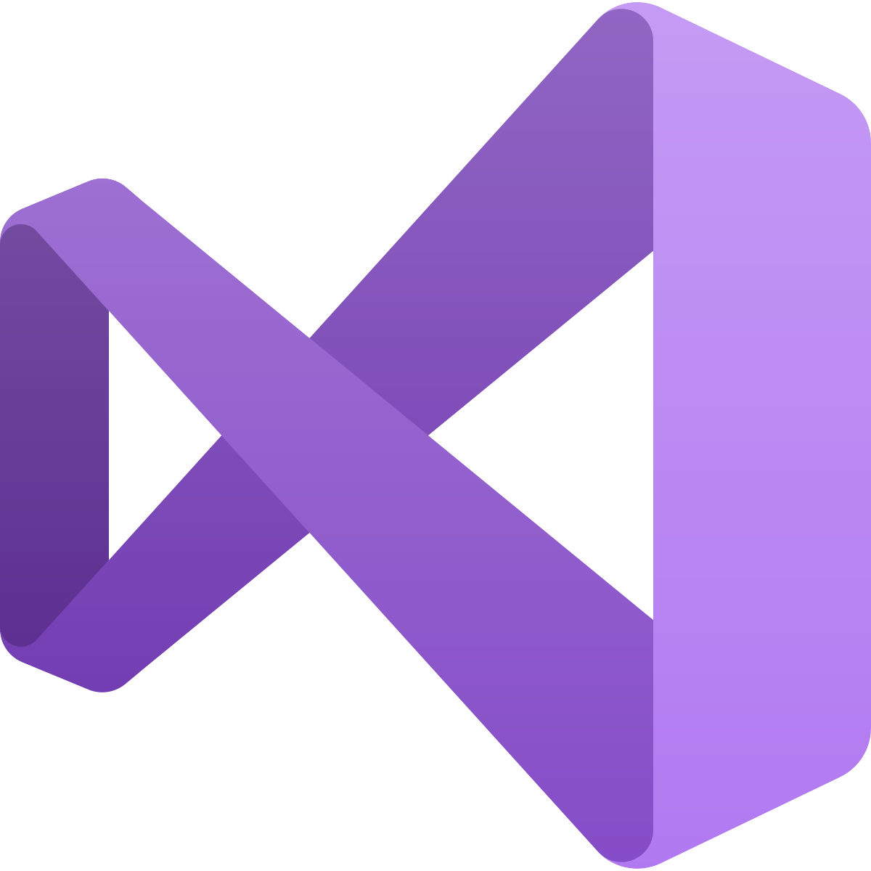
Sample of available tools
+ Azure Tools Extension
+ Azure Toolkit Plugin
+ Azure Toolkit
+ Cloud Explorer
Notes:
Lots of tools for use with Azure
These tools use the Azure Resource Manager REST API

Slide 11
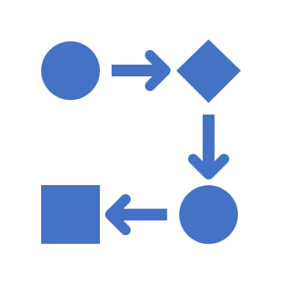


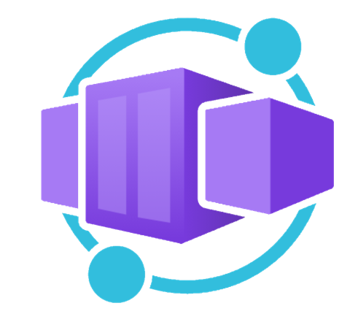


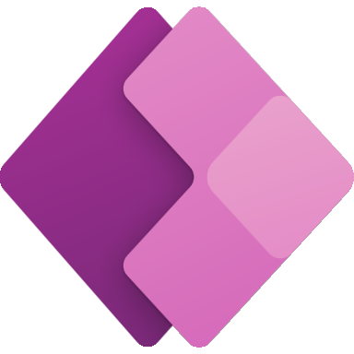
Application hosting continuum
IaaS
Infrastructure Platform
CaaS
Container Orchestration
Platform
PaaS
Application Platform
FaaS
Serverless Platform
Low Code
App and Orchestration
Platform
Virtual Machines
Azure Kubernetes
Service
Azure Container Apps
Azure Spring Apps
Azure App
Service
Azure Functions
Azure Logic
Apps
Power Apps
More Control of execution environment
Less Control of execution environment
Less Agile development & deployment
More Agile development & deployment

Slide 12
Web Solutions
Building resilient, web-based solutions on Azure with Azure App Service

Slide 13
Java (Spring)
.NET
Node.js
PHP
Ruby on Rails
Python
(Container)
How do I host a
web app in Azure?
Notes:
Let’s ask ourselves the question… How do I host my web app in Azure?
There is more than one service that can provide app hosting.
Today we will cover Azure App Service.
The platform supports a lot of different native web frameworks and languages.
If App Service doesn’t support what you use out-of-the box (like a Golang Gin App),
Or if you prefer to containerize your web apps. There is also an option to host containerized apps on App Service

Slide 14
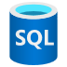

Web solution architecture
Azure App Service
Web App
Database
File Storage
Azure SQL Database
Azure Storage Account
Notes:
Let’s take a look at a standard web solution. This solution might have
A server-side app
A database
And file storage
Well, Hosting this solution in Azure could look like this
Azure App Service for hosting the web app
Azure SQL Database for hosting the database
Azure Storage Account Blob Containers for hosting the files

Slide 15
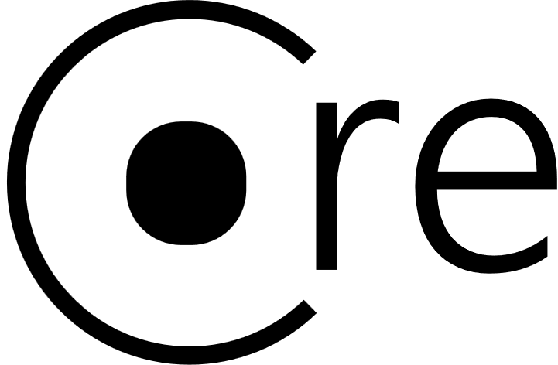



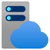

Azure App Service
App Service
(Web App)
App Service Plan
Notes:
An App Service sometimes called a Web App and is hosted on an App Service Plan
Each App Service Plan is a set of virtual machines (called instances)
Each App Service hosted on an App Service Plan has an instance of the app running on each instance in the plan
Requests to an App Service get load-balanced across all instances in the plan
The App Service Plan has specific computing sizes to choose from (called a sku)
App Service Plans can host either Linux or Windows VMs
Multiple App Services can run on a single App Service Plan
Each App Service could host a different web app language/framework as long as it works on the OS.
The OS is set at the App Service Plan whereas the language/framework is set at the web app.

Slide 16
Scale Out/Up
Scale Out
(Instance)
App Service (Web App A)
App Service (Web App B)
Instance 1
Instance 2
Instance 3
Scale Up
(SKU)
App Service Plan
Notes:
One of the feature of Azure App Service that we will talk about is scaling. There are 2 type of scaling methods, Automated or Manual.
If you setup up the automated scaling, then the app plan will add or remove instances bases on load characteristics (like CPU or memory utilization).
On the other hand, manual says it all. You can manually increase or decrease instance count to set the instance size.
If you look at the diagram on screen you will see if you scale out (adding instances) all apps in the plan will scale across all instances. If you scale up (adding resources like CPU and Memory) all app scale to use those new resources. So, simply said, All apps in the same App Service Plan share instances and compute power.
One question you should ask yourself is …
Should I put an app in a new plan or an existing plan?
You should Isolate your app into a new App Service plan when:
The app is resource-intensive. Or
You want to scale the app independently from the other apps in the existing plan. Or lastly
The app needs resource in a different geographical region.

Slide 17

Deployments
Non-Production Environment
Production Environment
Swap
(Production Slot)
(Staging Slot)
(Production Slot)
App Settings:
{
“apiUrl”: “https://non-prod.api.com”,
“senderEmail”: “devteam@company.com”
}
App Settings:
{
“apiUrl”: “https://prod.api.com”,
“senderEmail”: “us@company.com”
}
Notes:
Now let us talk about deployments.
You can use a build and deployment pipeline like
GitHub
Azure DevOps
Jenkins
or a CLI
So how would that look. If you deploy out to non-prod environment
You get App Settings that is used to set per-app-service environment settings that are Injected as environment variables
Now we deploy our app to production, and we see that Prod has its own app settings.
There is another feature called Deployment slots. Normally you only do this in your prod environment. Let's look at an example slot deployment set up for prod.
You would have 2 slot, one for Staging and one for the live prod app.
Deploy to a “staging” slot in your production environment. Allows you to warm the app up and validate the application is ready.
Then you can swap the applications deployed in the staging & prod slots
Essentially 0 downtime for users and now the old prod slot become staging, and the old app is readily available if you need to back out the deployment and revert to the previous status if something goes wrong.

Slide 18












Additional Services
Private
Link
API Management
Traffic
Manager
App
Gateway
Front
Door
Virtual Network
Application
Insights
Key Vault
App Service
Log
Analytics
Azure
SQL
PostgreSQL
Cosmos
Redis
Cache
Storage
Account
Notes:
Let’s talk about some additional services that are typically used with App Service.
Routing and ingress
Private Link – Lock down ingress to an IP address in your private Vnet
API Management – Expose APIs to consumers, perform routing and translation, set rate limits
Traffic Manager – DNS based regional traffic routing
App Gateway – Layer 7 (route based) traffic routing and Web Application Firewall
Front Door – Traffic Manager and App Gateway together
Data persistence
Relational Offerings
Azure SQL the PAAS offering of SQL Server
Azure Database for PostgreSQL (also MySQL or MariaDB)
Cosmos – Non-relational database with API facades for Core SQL, Mongo, Cassandra, Gremlin, and a Table API
Storage account – BLOB (file) storage
Security
Virtual Network – Protect and access resources in a private network
Key Vault – Store sensitive encryption keys, application secrets, or certificates
Observability
Application Insights – Application Performance Monitoring and logging
Log Analytics – Log ingestion (backing store for App Insights)

Slide 19
Application hosting continuum
IaaS
Infrastructure Platform
CaaS
Container Orchestration
Platform
PaaS
Application Platform
FaaS
Serverless Platform
Low Code
App and Orchestration
Platform
Virtual Machines
Azure Kubernetes
Service
Azure Container Apps
Azure Spring Apps
Azure App
Service
Azure Functions
Azure Logic
Apps
Power Apps
More Control of execution environment
Less Control of execution environment
Less Agile development & deployment
More Agile development & deployment

Slide 20
Web Solutions Lab
Azure App Service
Azure SQL Database
aka.ms/azuredevdaylabs/web
Azure Dev Day
Notes:
Feel free to mute me and work on the lab by yourself
I’m going to walk through the lab step-by-step if you want to follow along

Slide 21
Serverless Solutions
Building highly-scalable, event-driven applications.

Slide 22
Application hosting continuum
IaaS
Infrastructure Platform
CaaS
Container Orchestration
Platform
PaaS
Application Platform
FaaS
Serverless Platform
Low Code
App and Orchestration
Platform
Virtual Machines
Azure Kubernetes
Service
Azure Container Apps
Azure Spring Apps
Azure App
Service
Azure Functions
Azure Logic
Apps
Power Apps
More Control of execution environment
Less Control of execution environment
Less Agile development & deployment
More Agile development & deployment

Slide 23


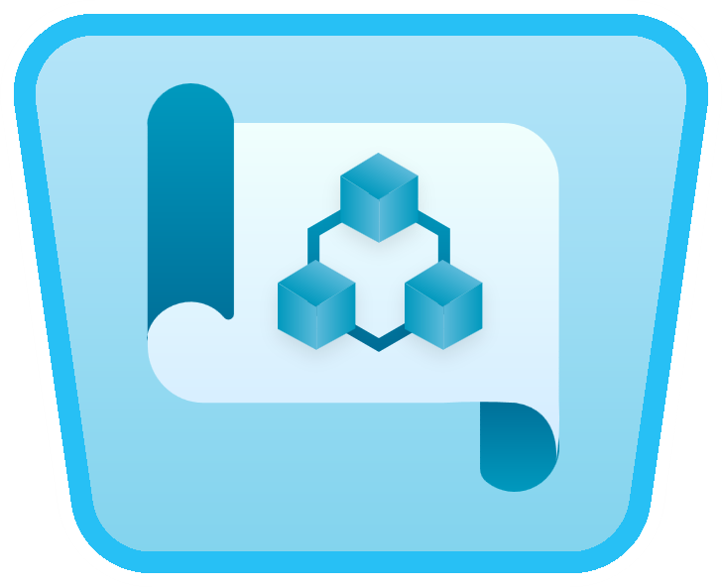
“Serverless” benefits
No server management
Developers can just focus on their code—there are no distractions around server management, capacity planning, or availability.
Event-driven processing
Application components react to events and triggers in real-time.
Consumption billing
Only pay for what you use by automatically scaling up and down based on system usage and throughput.
Microsoft Azure Well-Architected Framework
Guiding tenet, framework and best practices
Reliability, Security, Cost, Operational and Performance
*Supporting services, like storage and networking, may be charged separately.
Notes:
Serverless is actually a misnomer
Still servers behind the scenes running platforms and software
You don’t manage them
Serverless is designed for event-driven processing
The event source can be many things
You only pay for what you use
Azure WAF principles support serverless technology

Slide 24

Serverless architecture
Use case(s) and patterns
Order management
Service delivery
Financial transactions
Azure API Management
(Modify Order)
Azure Event Grid Topic
(New Order Event)
Azure Functions
(Order Processing)
Azure Event Grid Topic
(Order Change Event)
Azure Cosmos DB
(Order Database)
Notes:
A very-high-level architectural diagram of a serverless solution
Two types of events are flowing in
Events from an Event Grid Topic (New Order from up-stream system)
HTTP Request from a client application as a Web API (Modify an order)
Cosmos DB is storing all of the data
One type of event flowing out
Events going to an Event Grid Topic (Downstream system processing of order change events)
All of this is glued together by the code hosted in Azure Functions
Small snippets of code to handle these various cases (All of the order processing functionality)

Slide 25
Anatomy of a Function App
Trigger Event
Trigger Event
Trigger Event
Function App
(Functions)
Notes:
The unit of deployment is a Function App
Each Function App can contain 1 to many Functions
The unit of execution is a Function
Each Function has specific code it executes when triggered

Slide 26
Anatomy of a Function
2. Input Binding(s)
Read data from event (use Input binding)
Read data from external service
1. Trigger
4. Outputs
Event Grid, Logic App, REST, API, …
Write data to external service (use Output binding)
External endpoints using SDK libraries
3. Function Processing & Logic
Notes:
Each individual function has 4 parts
Trigger (Required) – defines what causes a function to execute
Input Binding(s) (Optional) – retrieves additional data before your code executes for usages in your code execution
Logic (Required) – Your code that performs whatever operations you need on the trigger and input binding data
Output Binding(s) (Optional) – Send data on to other event/messaging systems or to databases
Bindings are part of the overall Functions programming model
You don’t have to use them (You can still use SDKs and libraries in your logic to connect to other systems and databases)
They will speed up your development process
Abstract away connection concerns

Slide 27
Thinking about Functions
Integrated programming model
Use built-in triggers and bindings to define when a function is invoked and to what data it connects
Single responsibility
Functions are single-purposed, reusable pieces of code that process an input and return a result
Short lived
Functions don’t stick around when finished executing, freeing up resources for further executions
Enhanced development experience
Code, test and debug locally using your preferred editor or the easy-to-use web-based interface including monitoring
Stateless
Functions don’t hold any persistent state and don’t rely on the state of any other processes
Event driven & scalable
Functions respond to predefined events, and can scale out to handle high-load scenarios
Hosting options flexibility
Choose the deployment model that better fits your business needs without compromising development experience

Slide 28
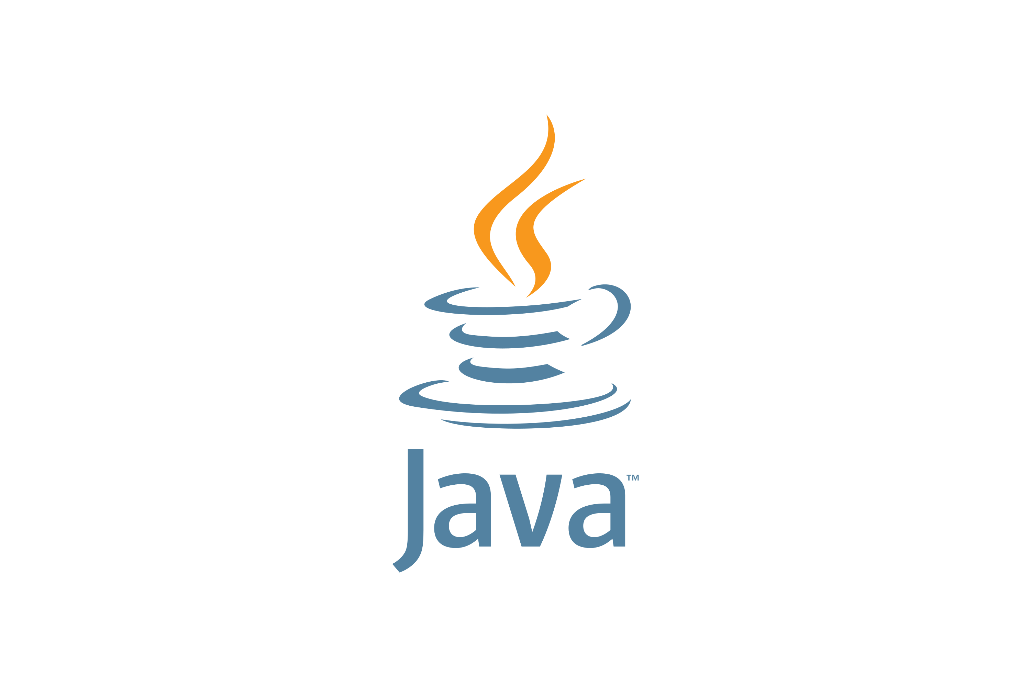

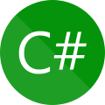
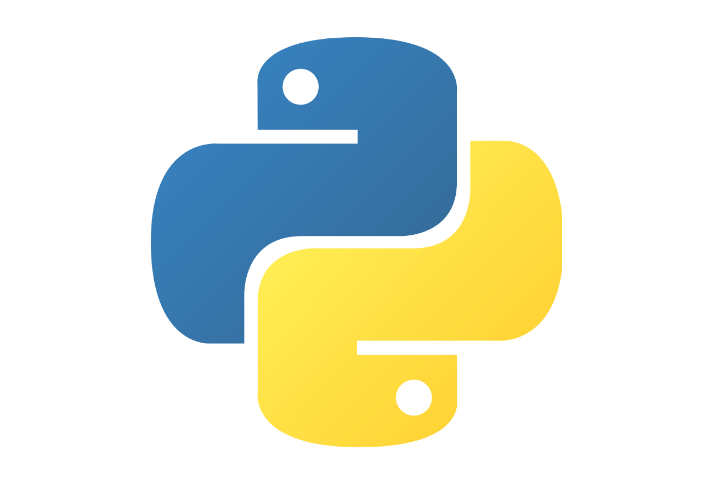


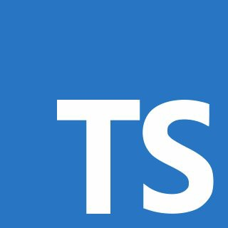

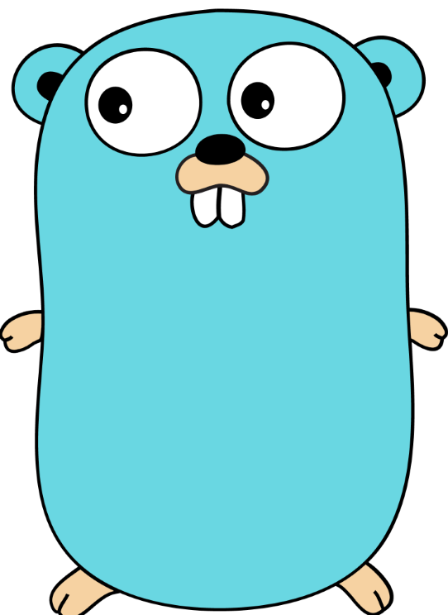
First-class Functions languages
Custom Handlers
Notes:
C#
Java
Python
Powershell
F#
JavaScript
TypeScript (transpiled to JavaScript)
Any language that supports HTTP primitives as Custom Handlers

Slide 29


Events and messaging
Event Grid
Service Bus
Event Hubs
Modern event-based reactive systems (subscription)
Queue or topic; Publish, subscribe model;
1-to-1, or 1-to-many
High throughput event ingestion (streaming, IoT)
Notes:
Event Grid
Create topics for delivering batches of events
Each subscription corresponds to a delivery endpoint
Push based consumption mechanics
Batches of events are pushed to subscribers
Built in Azure system topics (like a blob hits a storage container) and custom defined topics
Service Bus
Queue or Topic (Pub/Sub) mechanism
Queue or Subscription messages are “consumed” (single consumer)
Pull based consumption mechanics
Supports large messages up to 100MB
Event Hubs
Large scale event ingestion
Has Kafka API
Pull based consumption mechanics
Consumers read events from the persistent event log
Consumers keep their own checkpoint to know what events they have already processed

Slide 30




API Management
Developers
Partner Systems
Mobile Apps
Web Apps
APIM policies controls
Subscription
Authorization
Quota, rate-limiting
Transformation
Header, data filtering
APIs (Azure, On-premises, AWS, GCP)
Notes:
API Management acts as a façade for your APIs
The APIs can be hosted anywhere
You can do authorization and authentication at the APIM level before requests hit your APIs
Very helpful when building HTTP triggered functions

Slide 31
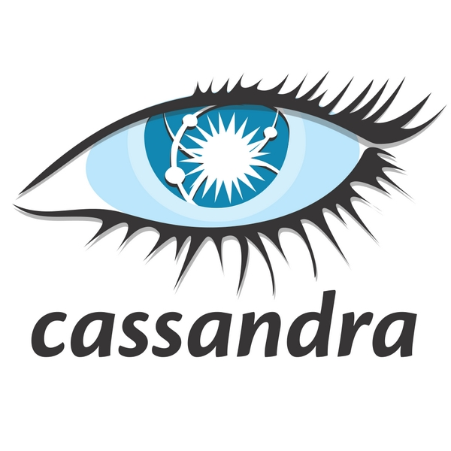

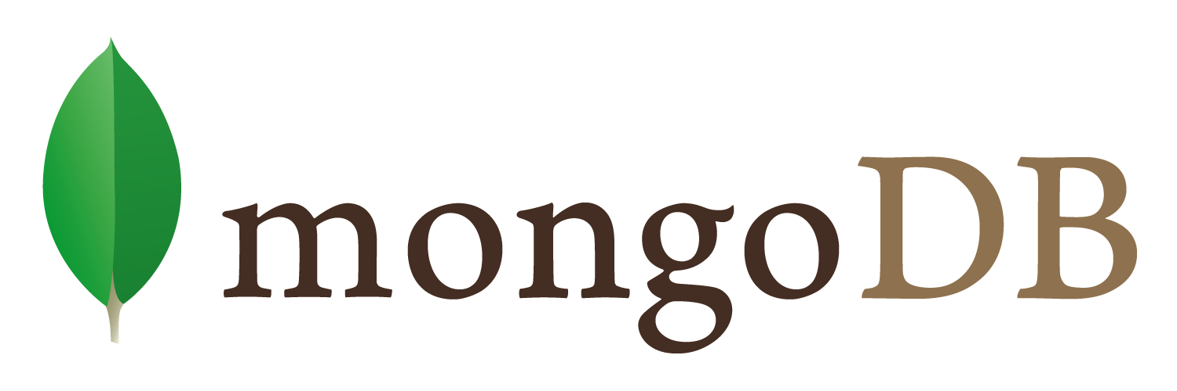

Cosmos DB
Notes:
Fully managed Non-relational database
Choose a specific API when provisioning a Cosmos DB account
Core (SQL) API – Document (JSON not file) database
Mongo DB API – Compatible with MongoDB client libraries, document database
Gremlin API – Graph database
Cassandra API – Column family database
Table API – Key-value pair database
Azure Functions has input & output bindings for the Cosmos Core (SQL) API

Slide 32
Application hosting continuum
IaaS
Infrastructure Platform
CaaS
Container Orchestration
Platform
PaaS
Application Platform
FaaS
Serverless Platform
Low Code
App and Orchestration
Platform
Virtual Machines
Azure Kubernetes
Service
Azure Container Apps
Azure Spring Apps
Azure App
Service
Azure Functions
Azure Logic
Apps
Power Apps
More Control of execution environment
Less Control of execution environment
Less Agile development & deployment
More Agile development & deployment

Slide 33

Serverless Solutions Lab
Files
Azure Blob Storage
Event Grid
Azure Functions
Cosmos DB
aka.ms/azuredevdaylabs/serverless
Azure Dev Day

Slide 34


Sign up for Microsoft.Source
Thank you!
Receive a regular digest of relevant technical content, events and training
Get the best of the newest resources, tools and guidance to help developers quickly build and deploy on Azure
Please fill out the Azure Dev Day Survey!
aka.ms/azuredevdaysurvey
And visit our event content page to access lab materials, presentations and more about the Microsoft Build Conference!
aka.ms/azuredevdaycontent
Get the latest articles, documentation, and events from Microsoft.Source—the curated monthly developer community newsletter.
Stay at the forefront of rapidly evolving technologies with resources that are relevant to your field, location, and areas of interest—including articles, GitHub repositories, and how-to guides.
Get notified about events—from local hacks, workshops, and training sessions to virtual meetups and global conferences.
Learn what you want, when you want, how you want. Resources include in-person hands-on workshops, free, interactive online training and sandbox environments.

